Slide 1
Natural Language Generation
Version 0.2
Ravi Joshi

Slide 2
Contents
Introduction Benefits NLG Architecture Key Capabilities (Narrative Science) Demo
Fidelity Confidential

Slide 3
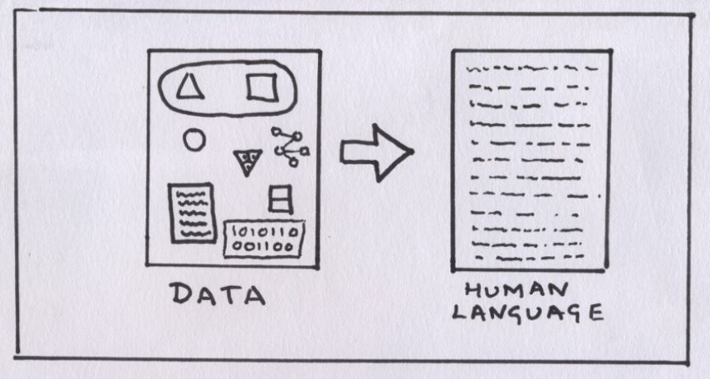
Introduction
What is Natural Language Generation?
Natural Language Generation (NLG), a subfield of artificial intelligence (AI) which produces language as output on the basis of data input, is not a new concept. What is new, however, is the increase in adoption of NLG into the enterprise. There are a plethora of ways the technology is being employed, primarily to improve human productivity, customer engagement and operational efficiency.
What’s the goal of NLG?
People have always communicated ideas from data. But with the explosion of data that needs to be analyzed and interpreted, coupled with increasing pressures to reduce costs and meet customer demands, the enterprise must find innovative ways to keep up.
As it turns out, a machine can communicate ideas from data at extraordinary scale and accuracy. And it can do it in a particularly articulate manner. When a machine automates the more routine analysis and communication tasks, productivity increases and employees can focus on more high-value activities.

Slide 4
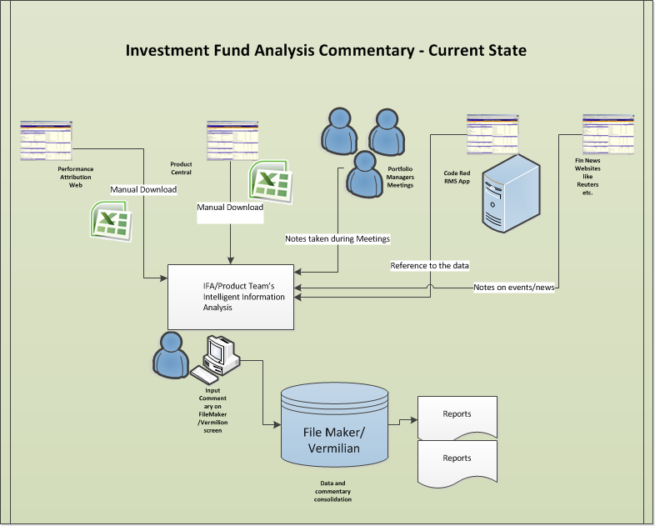
Introduction
How is Product Team can benefit with NLG Tool?
The benefit is enhancing human productivity and making people smarter. By eliminating repetitive, manual and time consuming analysis and reporting responsibilities, employees are freed to refocus their time, talents and skills on more strategic activities that drive competitive advantage and grow the FIL business. For example, Fund Commentary Automation.

Slide 5
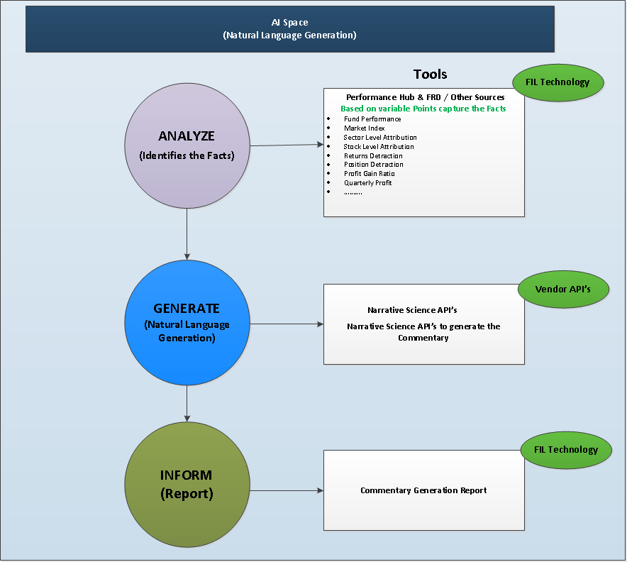
NLG Architecture

Slide 6
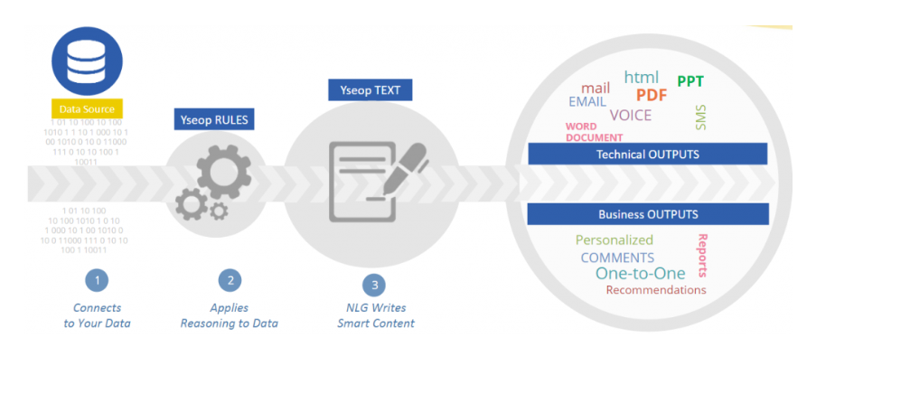
NLG Architecture – Yseop Product

Slide 7
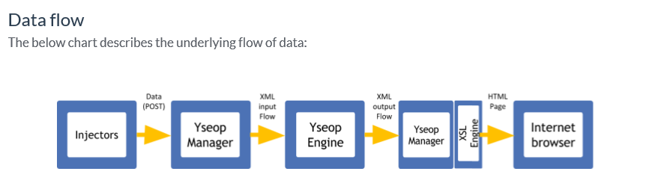
NLG Architecture – Yseop Product

Slide 8
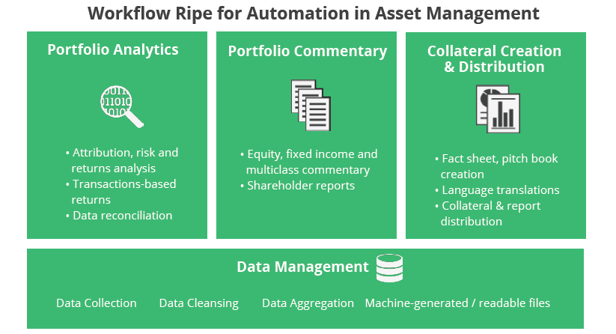
Key Capabilities (Narrative Science)
Automate Manual Tasks, Focus on High-Value Tasks
Think about all of the manual tasks related to data preparation, report creation, and content distribution that portfolio managers and Product team members do on a monthly or quarterly basis
Think about the time spent fact-checking commentary, styling fact sheets, and translating reports into multiple languages (If required)
On-demand automation will save time & meet the report distribution SLA’s

Slide 9
Demo

